Slide 1
Samsung Innovation Campus

Slide 2
Emotion Detection in Tweets
AI Avengers
Group members
Nahom Kidanemariam
Afrah Kausar
Amanda Tiwari
Ayesha Shakeel
Raj Dinesh Jagasia
Maged Mahmoud Abdalla

Slide 3



Introduction
People express themselves all the time on social media, sharing their opinions and emotions
Notes:
Note:

Slide 4
1.Useful when dealing with massive real-time text data generated via online platforms.
2.Resources associated with a human performing the task are impractical and complicated, hence machines can be leveraged
3. Useful for businesses to understand emotions towards their brands
Benefits of Emotion Detection

Slide 5
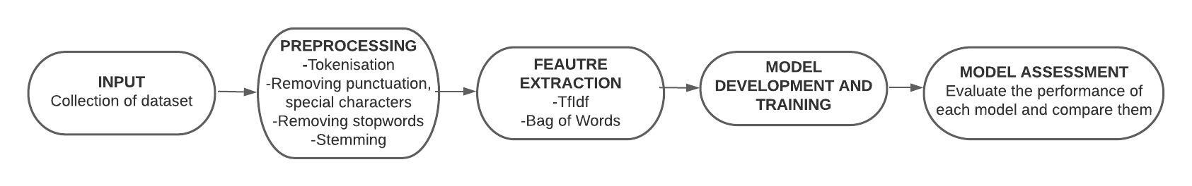
System Diagram
Notes:
Data preprocessing is a crucial step in any data analysis project to ensure accurate analysis.
Text data requires specific preprocessing steps to transform it into a format suitable for analysis.
Removing punctuation and URLs from text data is a crucial first step in data cleaning.
Removing stop words using NLTK is important as they do not contribute much to the meaning of the text.
Tokenizing involves splitting the text into individual words or tokens, making it easier to analyze.
Stemming is applied to reduce each word to its base or root form, which helps in text normalization.
By completing these steps, text data is transformed into a format suitable for further analysis, such as sentiment analysis or topic modeling.

Slide 6
Different training methodologies tried:
Strategy
Support Vector Machine (SVM)
Naive Bayes
Random Forest
LSTM
Transfer Learning

Slide 7
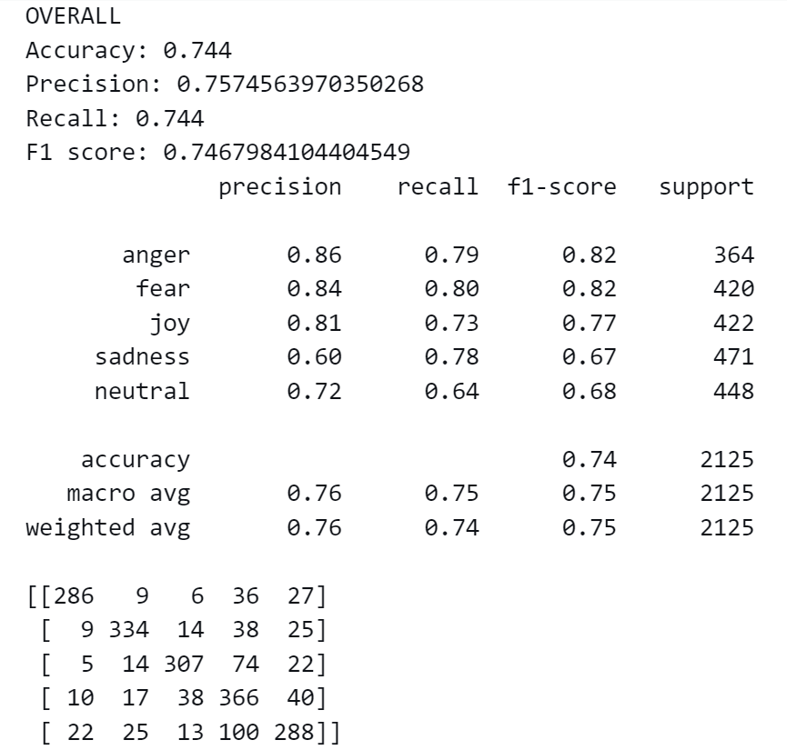
SVM (Support Vector Machine)
The overall accuracy of the SVM model was approximately 0.74. The model therefore correctly classified emotions to its respective tweet at a correctness of 74%.
After a certain few changes in the dataset, regularization parameter (C) and the type of SVC, the model was able to increase the accuracy from 33% to 74%. Fine tuning the model and improving feature extraction and selection methods can further improve the model.

Slide 8
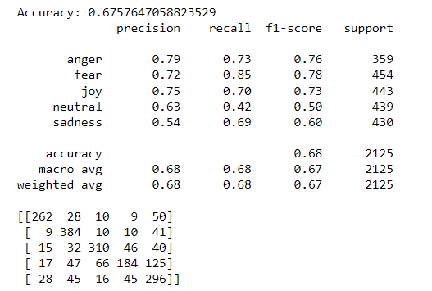
Overall, the accuracy score of this model is 0.675764, which means that the model has correctly predicted the sentiment of 67.57% of the instances in the test set.
This accuracy score is relatively good, but further analysis and tuning of the model may still be necessary to improve its accuracy further.
Naive Bayes

Slide 9
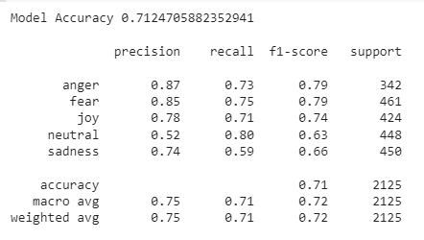
Random Forest
Random forest is a commonly-used machine learning algorithm which combines the output of multiple decision trees to reach a single result.
For feature extraction TF-IDF gave marginally better results. 200 n_estimators used.
Overall accuracy: 71.2%

Slide 10
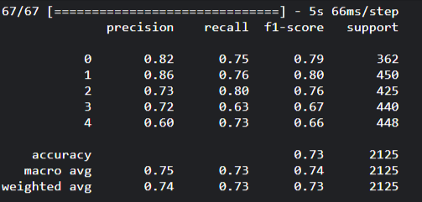
LSTM (Long Short-Term Memory)

Slide 11
We used the BERT model and trained it on our dataset to perform classification
BERT stands for Bidirectional Encoder Representations from Transformers.
It is a family of masked-language models published in 2018 by researchers at Google.
BERT is designed to help computers understand the meaning of ambiguous language in text by using surrounding text to establish context.
Transfer Learning

Slide 12
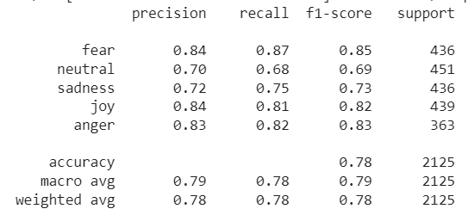
Transfer Learning

Slide 13
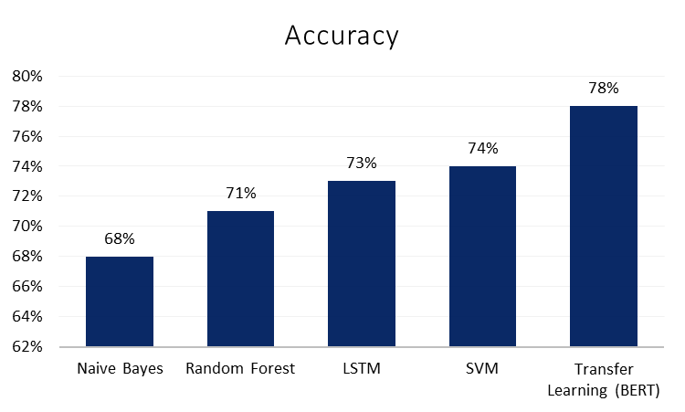
Comparison of Approaches

Slide 14
Future Improvements
We can further work on our best performing model to be able to classify more obscure language and phrasing.
We can deploy our model integrated with a web application to be deployed as a web tool.

Slide 15

Group Photo
Ai generated image of “six people programming” by DALL-E-mini

